Slide 1
Power Automate - Power User Module 3 – Intermediate
Sheldon Ledbetter Principle Customer Engineer

Slide 2

Objective
Understand how to use Power Automate together with SharePoint
Use variables
Data operations
Good practices

Slide 3
Follow along
Please see your workbook
Follow along
Start your PC and open https://flow.microsoft.com and sign-in.

Slide 4
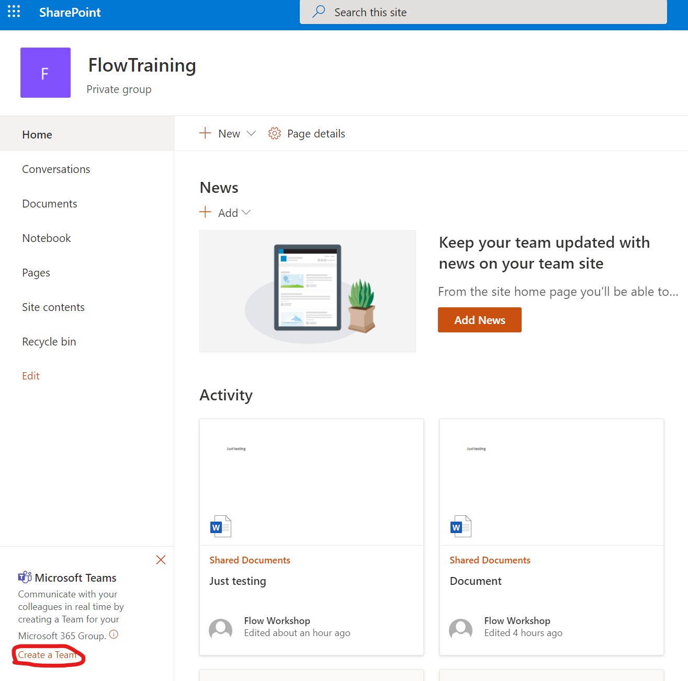
Flow and SharePoint Integration
Follow along
Create Team for FlowTraining site (if not already created) by clicking “Create a Team” on bottom left corner of the site

Slide 5
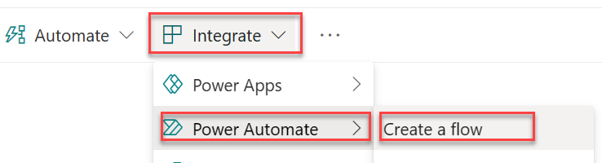
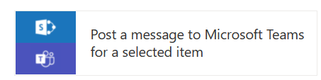
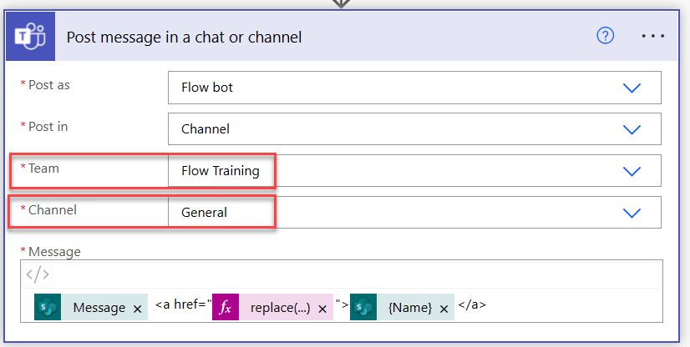
Lab 1 - Flow and SharePoint Integration
Follow along
Open Site contents > CarsList
Create new Flow by clicking Integrate > Power Automate > Create a flow
Select “Post a message to Microsoft Teams for selected item” from template selection panel (click see more)
Press Continue to confirm required SharePoint and Teams connections
Set Team and channel
Trigger of the Flow will be SharePoint “For a selected item” and you can see that site and list parameters are already populated automatically

Slide 6
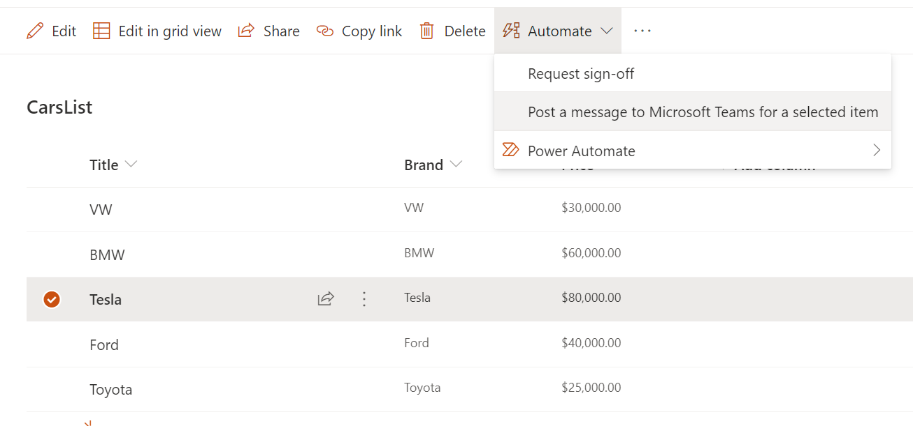
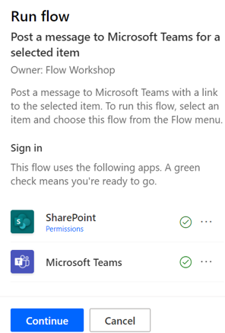
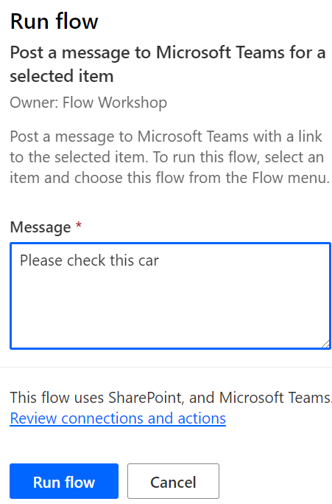
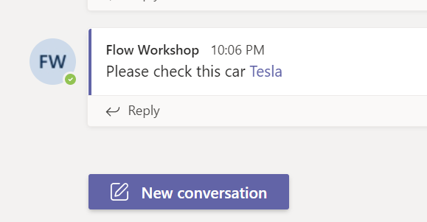
Lab 1 - Flow and SharePoint Integration – Launch Panel
Follow along
Select one item from the list and select Automate > Post a message to Microsoft Team for a selected item
Flow Launch Panel will open to right side of the page from where you can provide values to possible parameters and actually launch the Flow
See results from the FlowTraining Teams General channel (use web version of Teams)

Slide 7
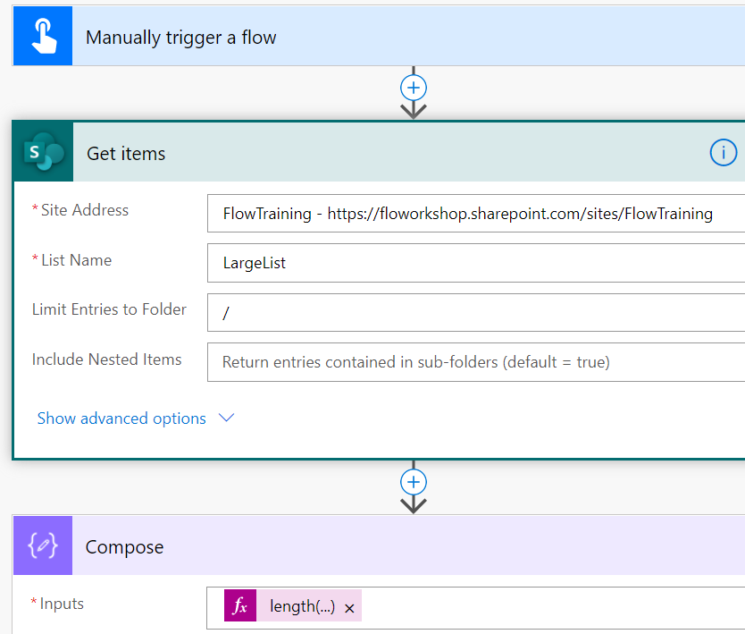
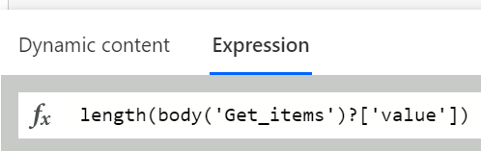
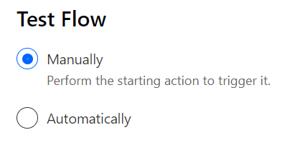
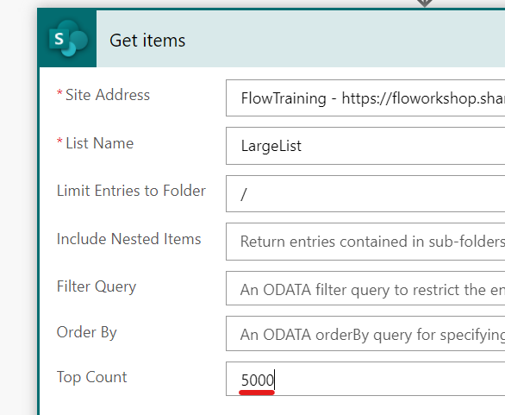
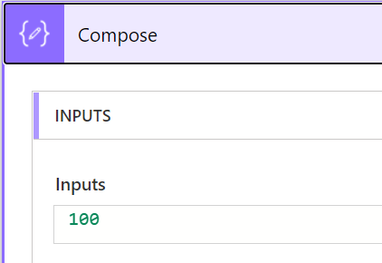
Lab 2 - Working with SharePoint lists
Follow along
Create new “Instant cloud flow” named “List Items” using “Manually trigger a flow” trigger
Add new step “Get items” (SharePoint)
Site Address: FlowTraining
List Name: LargeList
Limit Entries to Folder: / (without this ‘query limitation’ you will receive warning in Flow Checker)
Add new step Compose with expression length(body('Get_items')?['value'])
Save and test the Flow
Check the value of the Compose action which should be 100 even if that list contains thousands of items. “Get items” action returns only 100 items by default, but that can be changed in by setting “Top Count” value which can be maximum 5000 (SharePoint list view threshold)
Test with Top Count 5000 and 5001: what happens?
NOTE, if working with document library then you need to manually type library’s name (Enter custom value) as document libraries are not automatically listed in Get items action
Notes:
Follow along steps:
Create a new flow with the trigger – Flow Button
Add action – SharePoint Get items
Add the site FlowTraining and list LargeList
Add action Compose to count the number of items collected from the list. Add the Expression : length(body('Get_items')?['value’])
Run the flow and show that List only 100 items there is collected , but you can add up to 5000. So blank means 100

Slide 8
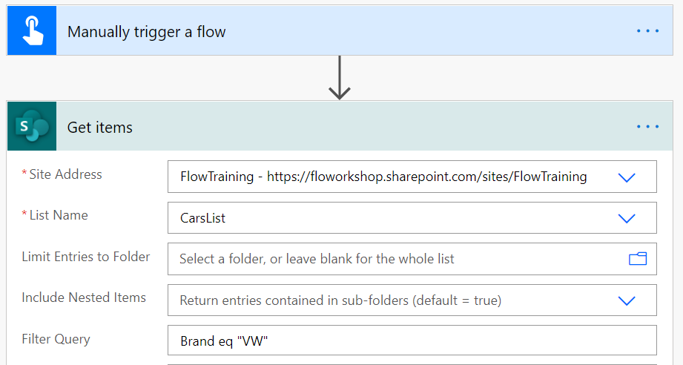
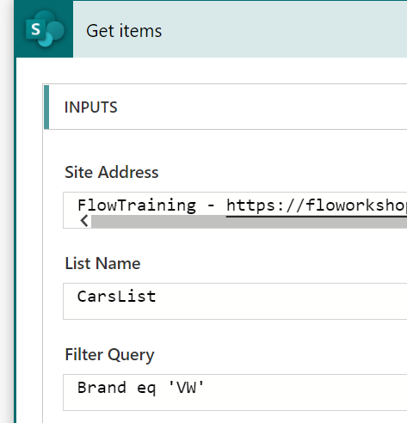
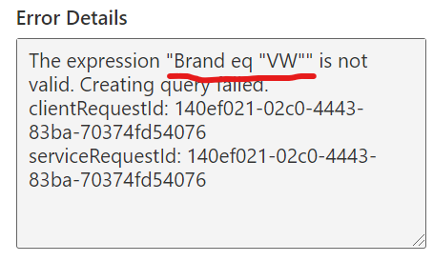
Lab 3 - Query SharePoint lists/libraries
Follow along
Create new “Instant cloud flow” named “SharePoint List Query” using “Manually trigger a flow” trigger
Add new step “Get items” (SharePoint)
Site Address: FlowTraining
List Name: CarsList
Filter Query: Brand eq "VW"
Save and test the Flow
Flow run will fail. Why? … because we used double quotes in filter and correct way is to use single quotes
Fix the Filter Query Brand eq 'VW'
Save and test again and now Flow should work correctly by returning only VW
https://docs.microsoft.com/en-us/sharepoint/dev/sp-add-ins/use-odata-query-operations-in-sharepoint-rest-requests

Slide 9
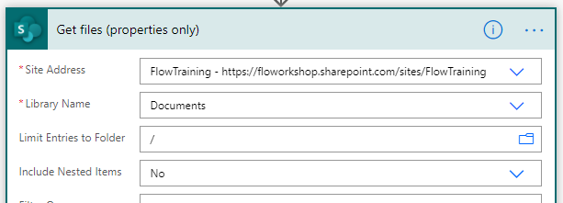
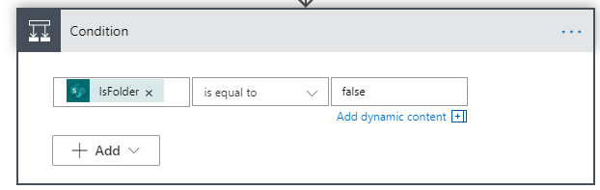
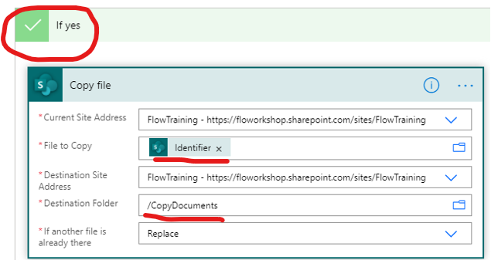
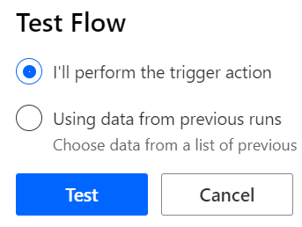
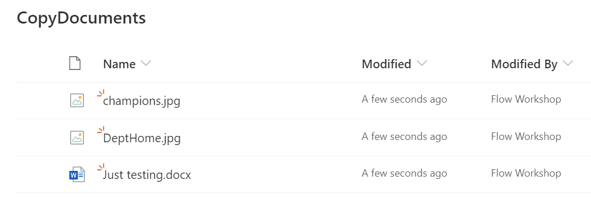
Lab 4 - Copy files
Follow along
Create new “Instant cloud flow” named “Copy Files” using “Manually trigger a flow” trigger
Add new step “Get files (properties only)” (SharePoint)
Site Address: FlowTraining
List Name: Documents
Limit Entries to Folder: /
Include Nested Items: No
Add new step “Condition”
Condition: IsFolder ‘is equal to’ false
NOTE! false need to be all lowercase in the condition and Apply to each action is automatically added to the Flow
Add new step “Copy file” to “If yes” branch of the condition
Current Site Address: FlowTraining
File to Copy: [Identifier] (dynamic content from Get files)
Destination Site Address: FlowTraining
Destination Folder: /CopyDocuments
If another file is already there: Replace
Save and test the Flow
Check that files from the Documents library are copied to CopyDocuments library

Slide 10
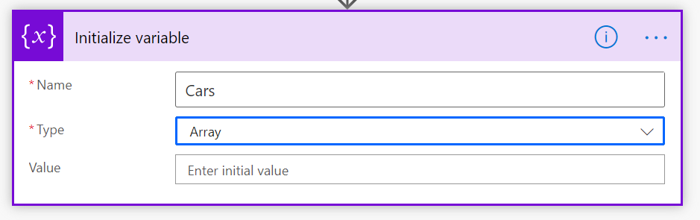
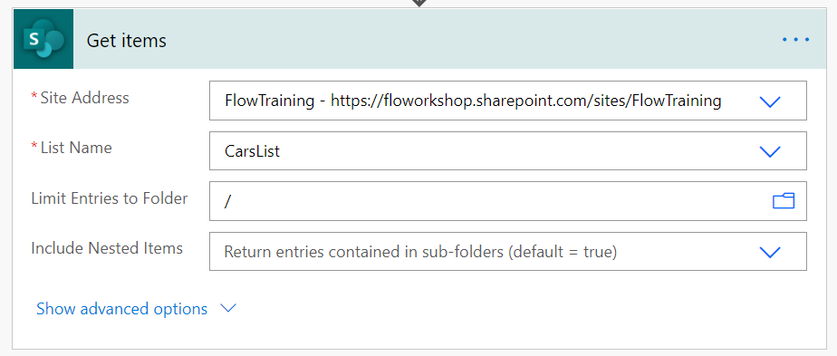
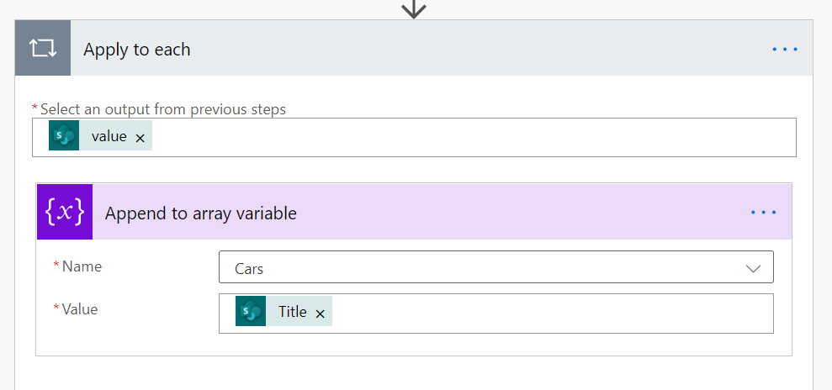
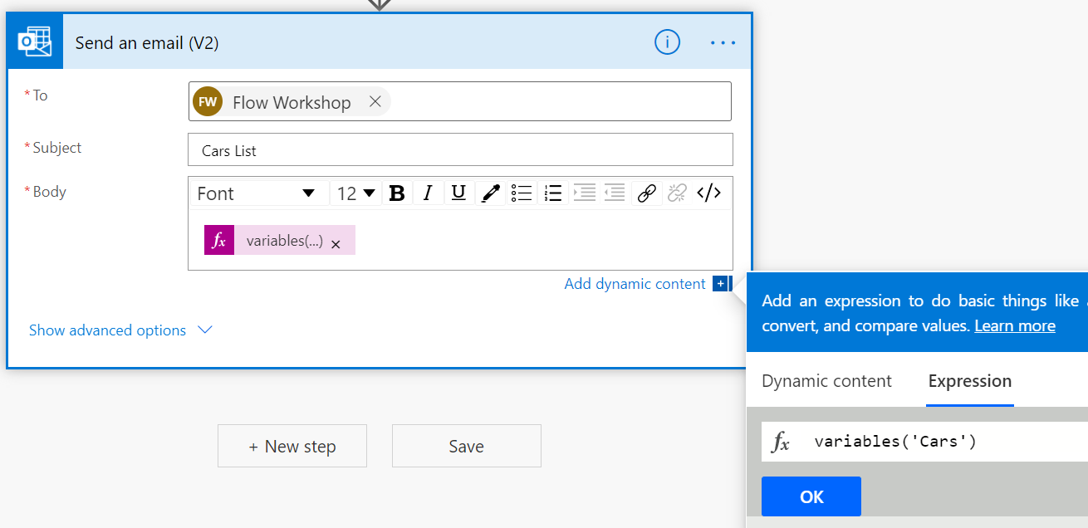
Lab 5 - Use variables (flow internal variables)
Follow along
Create new “Instant cloud flow” named “Use variables” using “Manually trigger a flow” trigger
Add new step “Initialize variable” – Name: Cars, Type: Array
Add new step “Get items” (SharePoint)
Site Address: FlowTraining
List Name: CarsList
Limit Entries to Folder: /
Add new step “Append to array variable”
Name: Cars
Value: [Title] (dynamic content from Get items)
NOTE! Apply to each action is automatically added to the Flow
Add new step “Append to array variable” (should be “Send an Email (v2)”
To: Your O365 email account
Subject: Cars List
Body: variables(‘Cars’)
Save and test the Flow
Check your O365 email where you should see mail from your Flow including list of all cars (title) in CarsList
For advanced variables: use azure logic apps workflow definition language

Slide 11
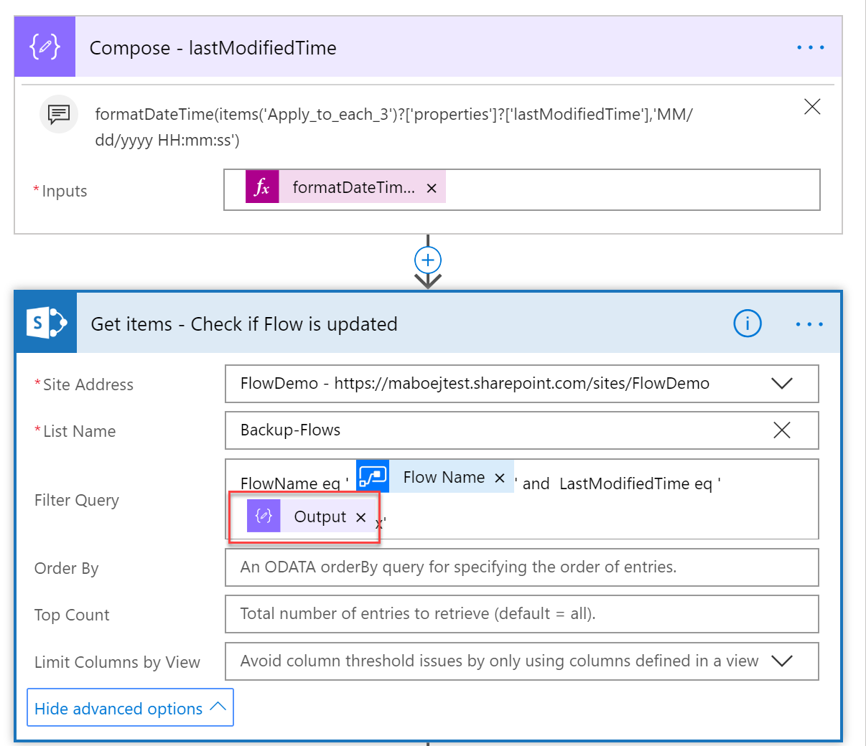
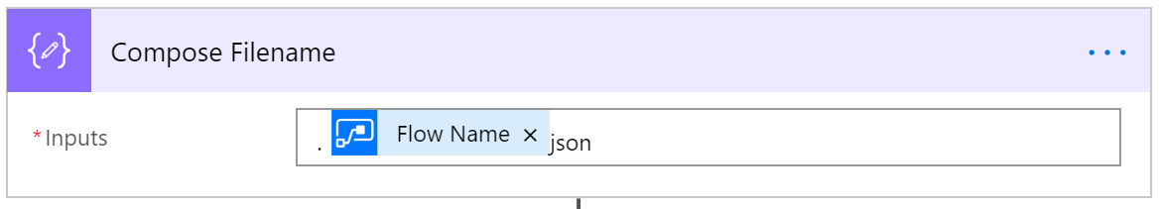
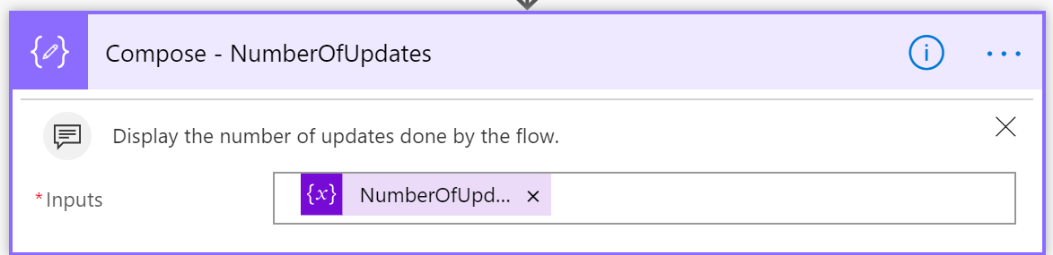
Good practice - Use compose
To do data operations and “debugging”

Slide 12
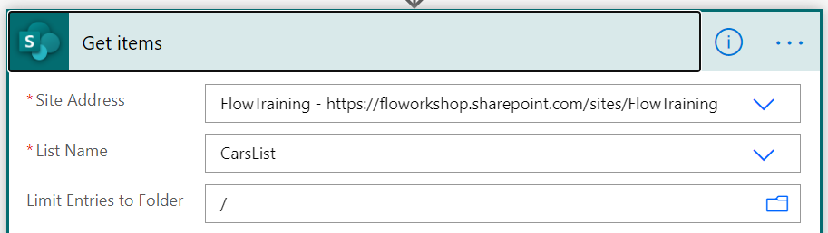
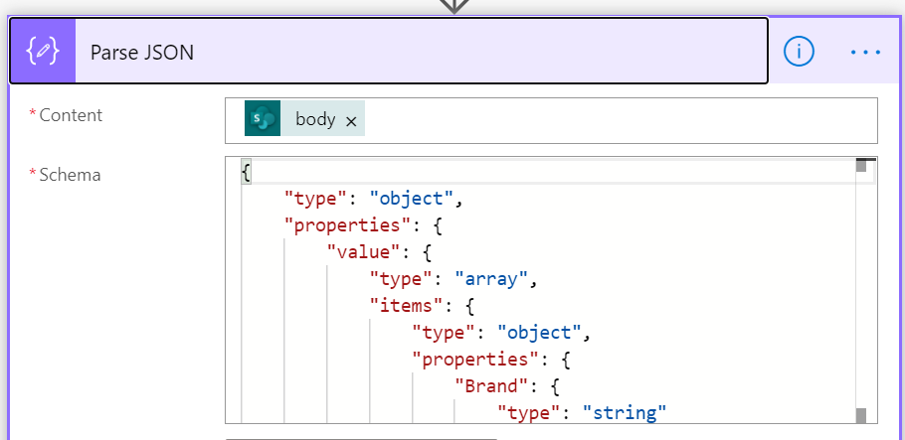
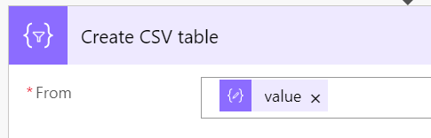
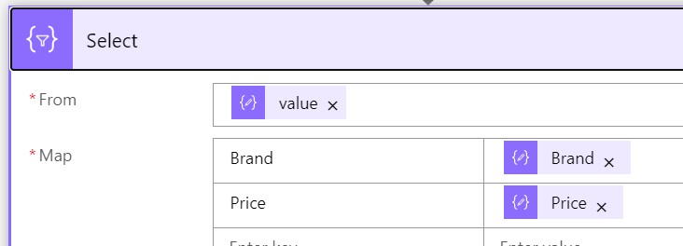
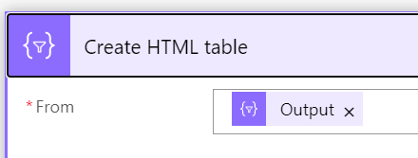
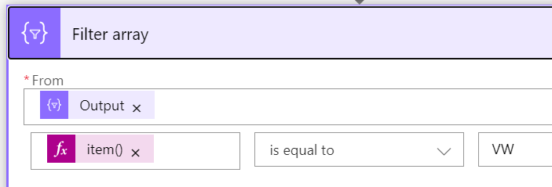
Lab 6 - Data operations
Follow along
Create new Flow named “Data operations” as “Instant – from blank”
Add new step “Get items” (SharePoint)
Site Address: FlowTraining
List Name: CarsList
Limit Entries to Folder: /
Add new step “Parse JSON”
Content: [body] (dynamic content from Get items)
Schema: {"type": "object","properties": {"value": {"type": "array","items": {"type": "object","properties": {"Brand": {"type": "string"},"Price": {"type": "integer"}}}}}}
Add new step “Create CSV table” (Data operation)
From: [value] (dynamic content from Parse JSON)
Add new step “Select” (Data operation)
From: [value] (dynamic content from Parse JSON)
Map: Brand -> [Brand] (dynamic content from Parse JSON)
Price -> [Price] (dynamic content from Parse JSON)
Add new step “Create HTML table” (Data operation)
From: [Output] (dynamic content from Select)
Add new step “Filter array” (Data operation)
From: [Output] (dynamic content from Select)
item()?['Brand'] ‘is equal to’ VW
Save and test the Flow
Notes:
Parse JSON schema
{
"type": "object",
"properties": {
"value": {
"type": "array",
"items": {
"type": "object",
"properties": {
"Brand": {
"type": "string"
},
"Price": {
"type": "integer"
}
}
}
}
}
}

Slide 13
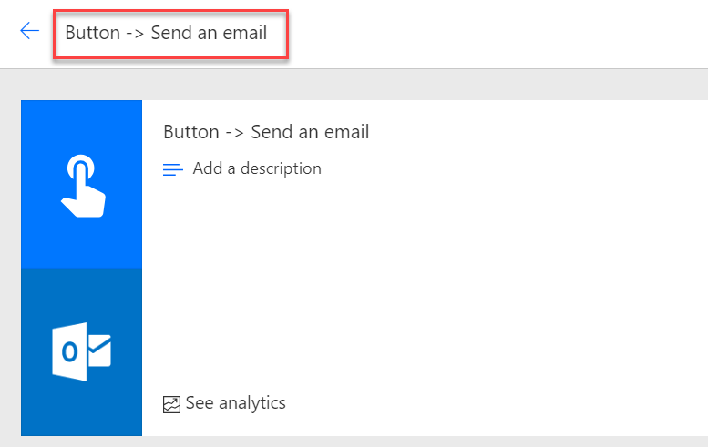
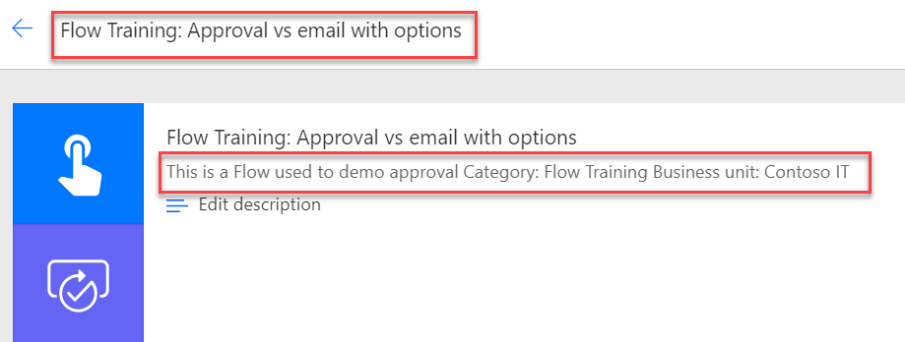
Good practice - Flow naming
BAD NAME
GOOD NAME
Description missing
Good Description

Slide 14
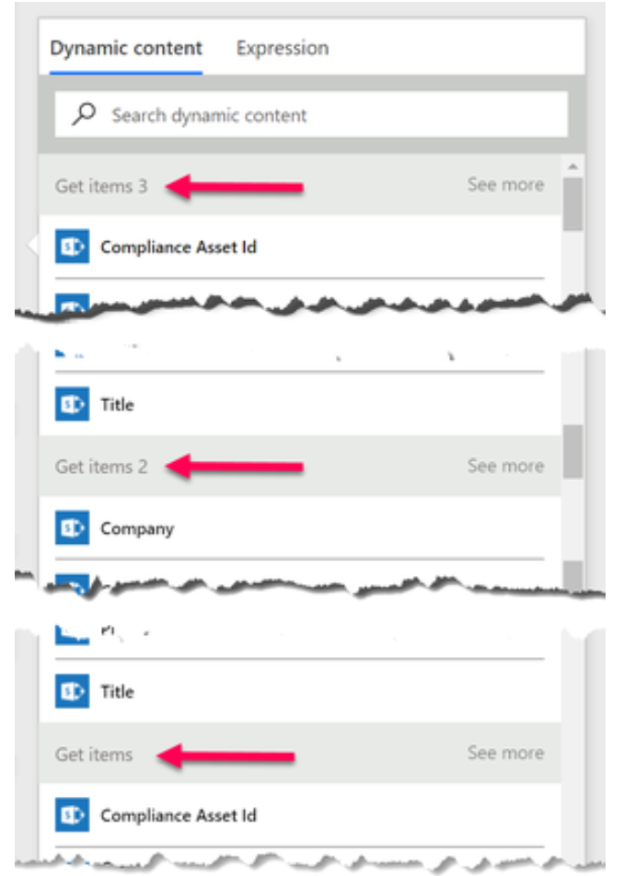
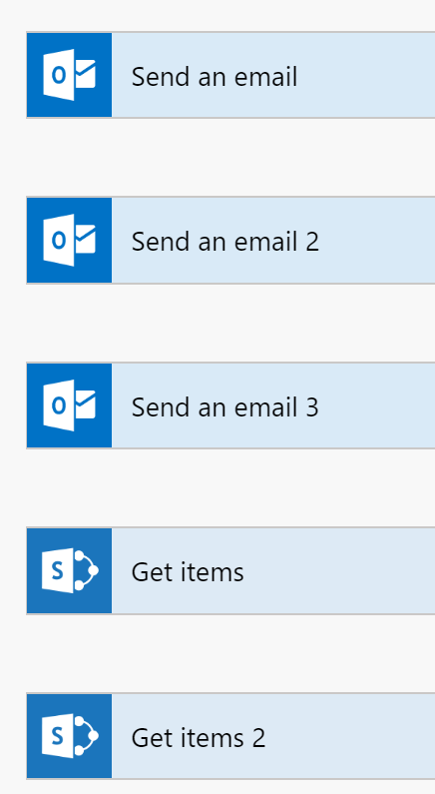
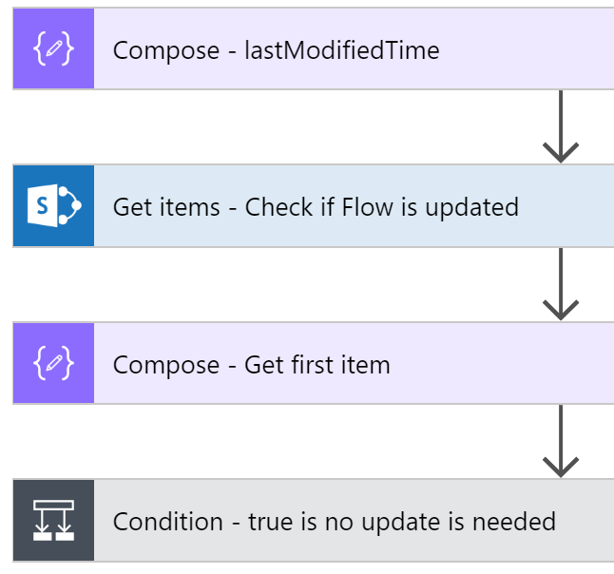
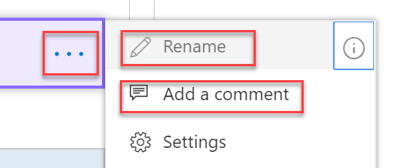
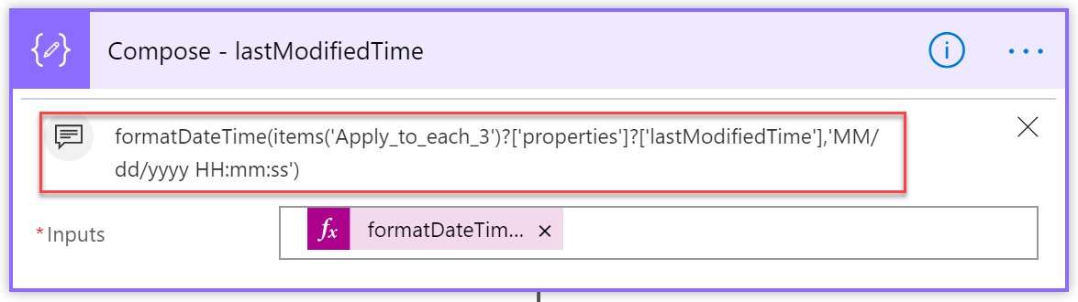
Good practice - Action naming
GOOD NAME
BAD NAME
Use comments
Notes:
The name should tell what the action is doing or the purpose of the action. Also add Comment to describe the Action.

Slide 15
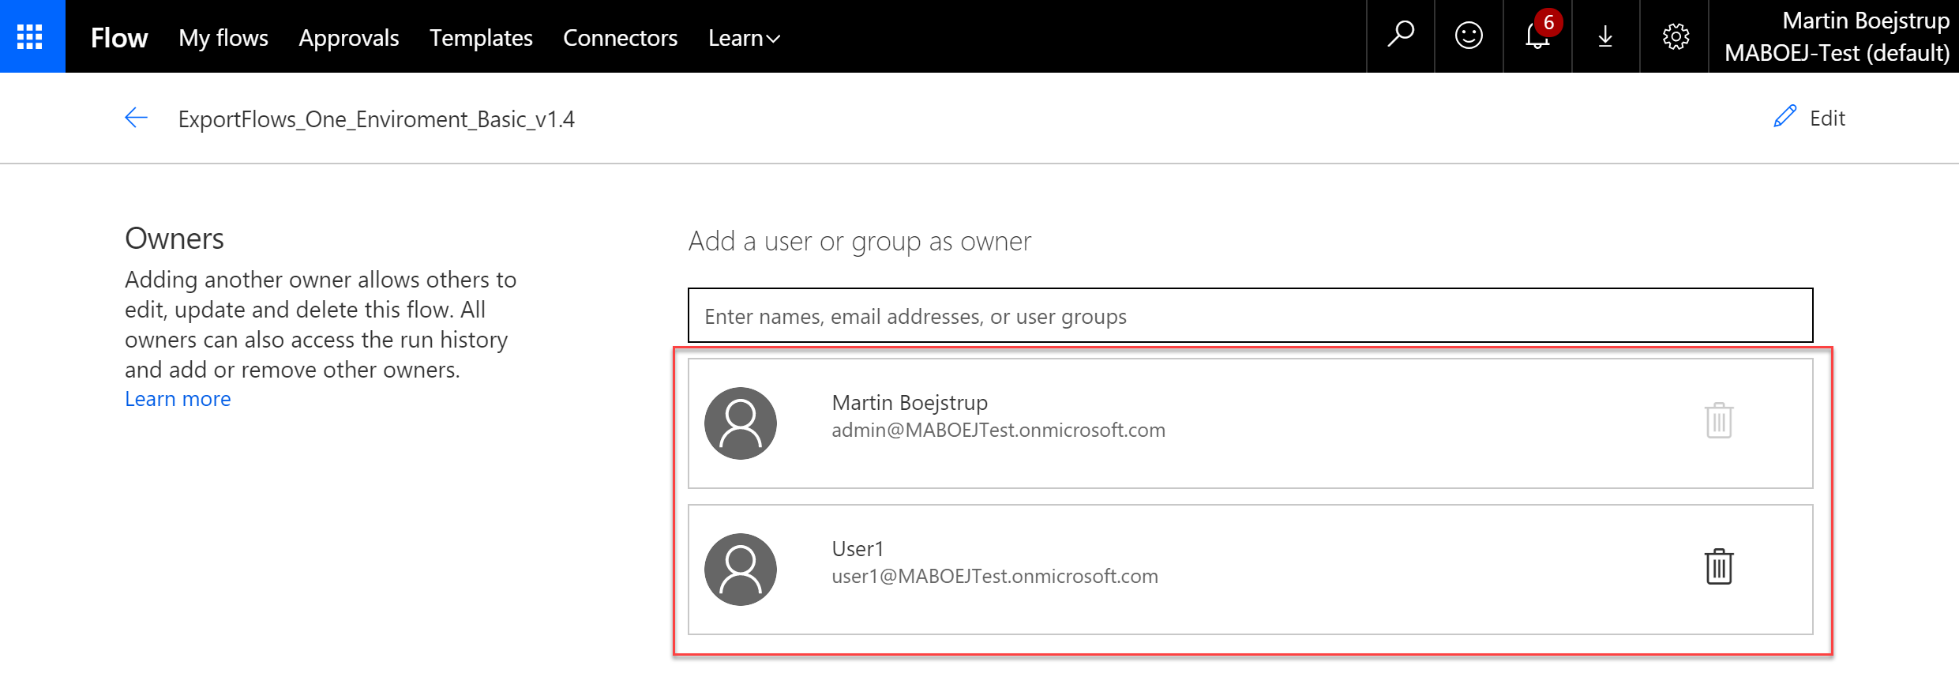
Good practice – Share Flows
Notes:
You should have more than 1 owner

